Slide 1
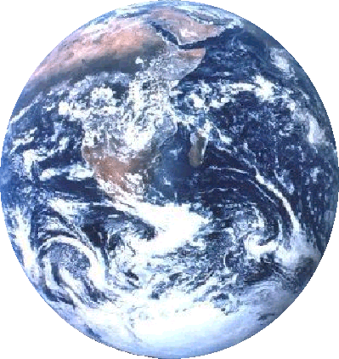
LES GRANDS BIOMES
D. VALLOD Cours d'écologie ISARA-Lyon 2èA

Slide 2
Qu'est ce qu'un biome ?
Type d’écosystème terrestre ou aquatique caractéristique de
grandes zones géographiques
présentant des conditions particulières.
Climat
  Température
  Précipitations
Géographie
Perturbations
périodiques
Biomes
Faune
Flore

Slide 3
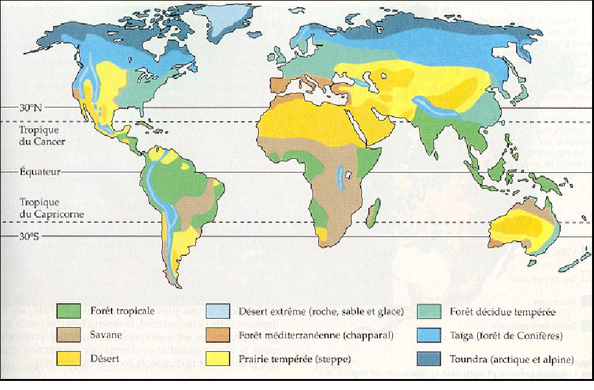
Les principaux biomes terrestres
Carte extraite de "Biologie, 2è édition française, 2004, Neil A. Campbell & Jane B. Reece, Éditions DE BOECK UNIVERSITÉ, 1482 p."

Slide 4
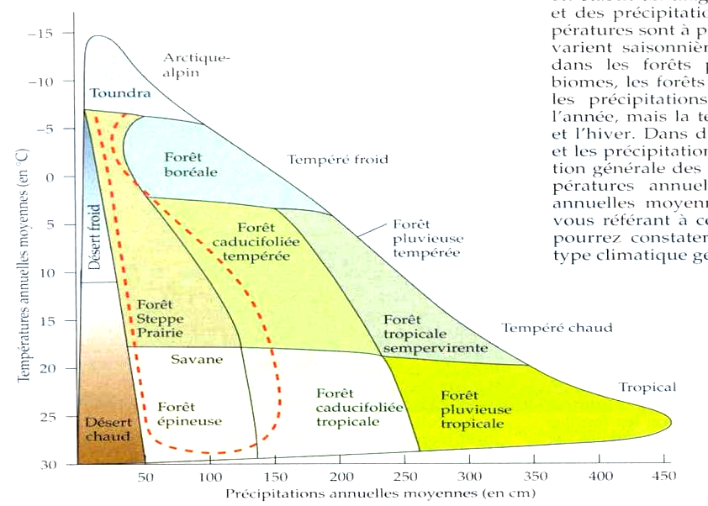
Biomes et climat
Influence d'autres facteurs : saison sèche, incendies, pâturage, …. sur le type de biome présent
http://instruct.uwo.ca
Notes:
Préférer la fig de Campbell, p 1071

Slide 5
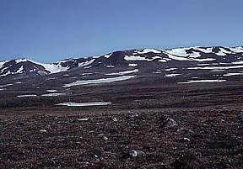
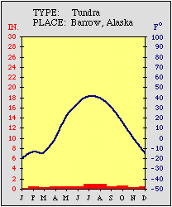
La toundra
Température :
- 34°C en hiver,
+ 3 à +12°C en été
Pluies : 150 à
250 mm/an
Végétation: lichens, broussailles, carex,
mousses, …
Permafrost = couche de sol toujours gelée
Faune : herbivores (lemmings,
caribou, …), carnivores (renard
arctique, loup, ours polaire), nombreux
oiseaux migrateurs, insectes, poissons.
Situation : Sud de l’Arctique, Sibérie, Nord
de l’Europe et de l'Amérique,
www.ucmp.berkeley.edu
Le plus froid des biomes
Courte saison de croissance et
de reproduction (50 à 60 j)
Grandes variations dans les
populations
Notes:
The tundra is the coldest of the biomes. It also receives low amounts of precipitation, making the tundra similar to a desert. Tundra is found in the regions just below the ice caps of the Arctic, extending across North America, to Europe, and Siberia in Asia. Much of Alaska and about half of Canada are in the tundra biome. Tundra is also found at the tops of very high mountains elsewhere in the world. Temperatures are frequently extremely cold, but can get warm in the summers.
Tundra winters are long, dark, and cold, with mean temperatures below 0°C for six to 10 months of the year. The temperatures are so cold that there is a layer of permanently frozen ground below the surface, called permafrost. This permafrost is a defining characteristic of the tundra biome. In the tundra summers, the top layer of soil thaws only a few inches down, providing a growing surface for the roots of vegetation.
Precipitation in the tundra totals 150 to 250 mm a year, including melted snow. That's less than most of the world's greatest deserts! Still, the tundra is usually a wet place because the low temperatures cause evaporation of water to be slow. Much of the arctic has rain and fog in the summers, and water gathers in bogs and ponds.
Vegetation in the tundra has adapted to the cold and the short growing season. Mosses, sedges, and lichens are common, while few trees grow in the tundra. The trees that do manage to grow stay close to the ground so they are insulated by snow during the cold winters.

Slide 6
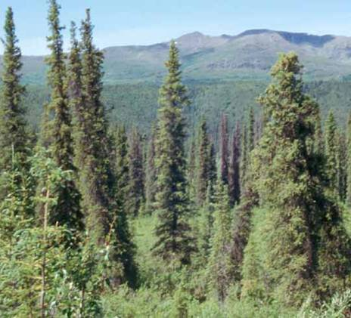
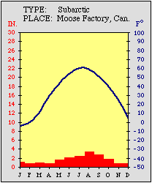
La Taïga
Température:
- 40°C à 20°
T° moy. estivale :
10 °C
Pluies :
400 à 1000 mm/an
Sol : mince, acide, pauvre en
nutriments
Végétation: Conifères
Faune : oiseaux, ours, renard et
loup, ….
Situation : Eurasie et Amérique du Nord ( 2/3 en Sibérie, le reste = Alaska, Scandinavie, et Canada)
Alaska - Juillet 1996 - Janine, Gérard et Sylvain Thomas
Le plus étendu des biomes
terrestres (entre 50 et 60 degrés
de latitude Nord)
Saison de croissance : 130 j
Notes:
Description: Between the tundra to the north and the deciduous forest to the south lies the large area of coniferous forest. One type of coniferous forest, the northern boreal forest, is found in 50° to 60°N latitudes. Another type, temperate coniferous forests, grows in lower latitudes of North America, Europe, and Asia, in the high elevations of mountains.
Coniferous forests consist mostly of conifers, trees that grow needles instead of leaves, and cones instead of flowers. Conifers tend to be evergreen, that is, they bear needles all year long. These adaptations help conifers survive in areas that are very cold or dry. Some of the more common conifers are spruces, pines, and firs.
Precipitation in coniferous forests varies from 300 to 900 mm annually, with some temperate coniferous forests receiving up to 2,000 mm. The amount of precipitation depends on the forest location. In the northern boreal forests, the winters are long, cold and dry, while the short summers are moderately warm and moist. In the lower latitudes, precipitation is more evenly distributed throughout the year.

Slide 7
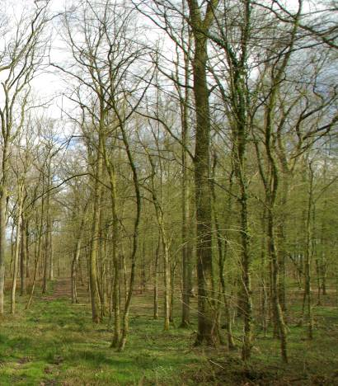
La forêt tempérée
Température: - 30°C à +30°C
Pluies : 750 à 1 500 mm/an
Sol : riche (Litière)
Végétation: chêne, hêtre, érable…
(Caractérisée par arbres à feuilles
caduques, croissance relativement faible, dormance saisonnière).
Faune : diversité modérée,
hibernation et migration
Situation : Est de l'Amérique du Nord, Nord-Est de l'Asie, Europe de l'Ouest et Europe Centrale
Saisons marquées
Biome fortement soumis à
l'influence humaine
Notes:
Temperate deciduous forests are located in the mid-latitude areas which means that they are found between the polar regions and the tropics. The deciduous forest regions are exposed to warm and cold air masses, which cause this area to have four seasons. The temperature varies widely from season to season with cold winters and hot, wet summers. The average yearly temperature is about 10°C. The areas in which deciduous forests are located get about 750 to 1,500 mm of precipitation spread fairly evenly throughout the year.
During the fall, trees change color and then lose their leaves. This is in preparation for the winter season. Because it gets so cold, the trees have adapted to the winter by going into a period of dormancy or sleep. They also have thick bark to protect them from the cold weather. Trees flower and grow during the spring and summer growing season.
Many different kinds of trees, shrubs, and herbs grow in deciduous forests. Most of the trees are broadleaf trees such as oak, maple, beech, hickory and chestnut. There are also several different kinds of plants like mountain laurel, azaleas and mosses that live on the shady forest floor where only small amounts of sunlight get through.

Slide 8
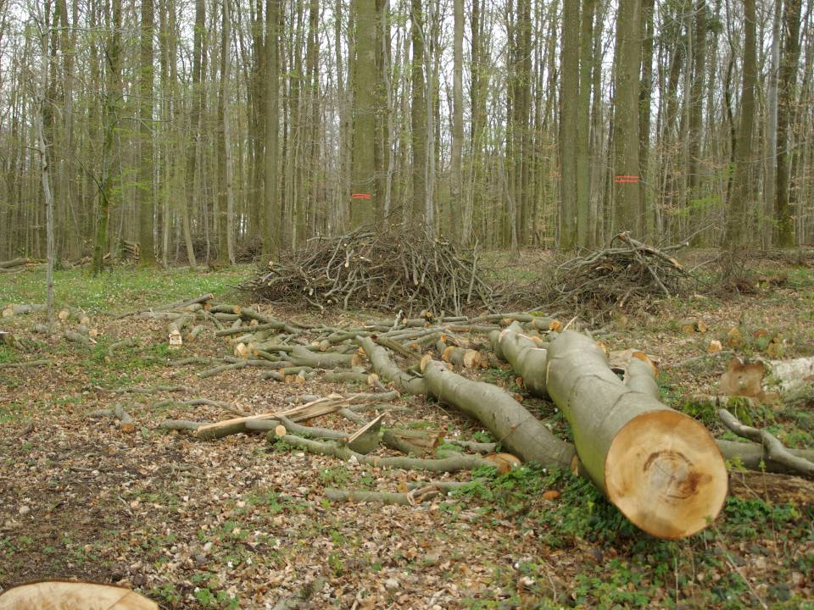
Il ne reste que quelques secteurs
de forêt tempérée originelle
en Europe Centrale….

Slide 9
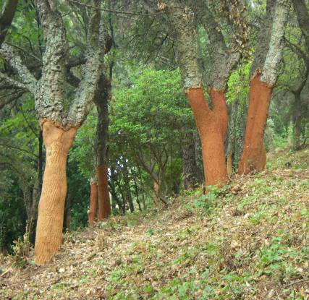
La forêt méditerranéenne
Température : en janvier -17°C
en Turquie, + 10°C au Maroc ;
en été : + 38°C. Moyennes
mensuelles de 5 à 18 °C.
Pluies : 100 mm/an en zones
pré-désertiques à 2500
mm/an sur certaines
montagnes exposées aux
vents humides
Végétation : chêne, olivier, pin
d'alep, thuya, châtaignier …
Situation : pourtour de la
Méditerranée + Californie, Chili,
Afrique du Sud, Australie
septentrionale.
Incendies périodiques
Occupation par l'homme ancienne
et forte a profondément modifié le
milieu
Notes:
Temperate deciduous forests are located in the mid-latitude areas which means that they are found between the polar regions and the tropics. The deciduous forest regions are exposed to warm and cold air masses, which cause this area to have four seasons. The temperature varies widely from season to season with cold winters and hot, wet summers. The average yearly temperature is about 10°C. The areas in which deciduous forests are located get about 750 to 1,500 mm of precipitation spread fairly evenly throughout the year.
During the fall, trees change color and then lose their leaves. This is in preparation for the winter season. Because it gets so cold, the trees have adapted to the winter by going into a period of dormancy or sleep. They also have thick bark to protect them from the cold weather. Trees flower and grow during the spring and summer growing season.
Many different kinds of trees, shrubs, and herbs grow in deciduous forests. Most of the trees are broadleaf trees such as oak, maple, beech, hickory and chestnut. There are also several different kinds of plants like mountain laurel, azaleas and mosses that live on the shady forest floor where only small amounts of sunlight get through.

Slide 10
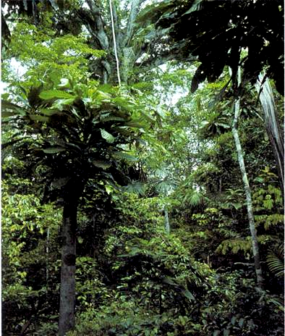
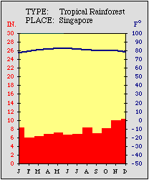
La forêt tropicale
Température:
20°C à 25°C
Pluies :
2 000 à
10 000 mm/an
Végétation: plus de 100 espèces d'arbres + lianes, orchidées, broméliacées, mousses, …
Faune : nombreux oiseaux, chauve-souris, petits mammifères et insectes.
Situation: entre le tropique du Cancer (23.5 °N) et celui du Capricorne (23.5 °S).
La plus grande biodiversité : 5 % de la surface terrestre, mais 50 %
des espèces connues sur Terre.
Biome fortement soumis à l'influence humaine : déforestation, érosion
des sols, atteintes à la biodiversité, ….
Notes:
There are two types of rainforests, tropical and temperate. Tropical rainforests are found closer to the equator where it is warm. Temperate rainforests are found near the cooler coastal areas further north or south of the equator.
The tropical rainforest is a hot, moist biome where it rains all year long. It is known for its dense canopies of vegetation that form three different layers. The top layer or canopy contains giant trees that grow to heights of 75 m (about 250 ft) or more. This layer of vegetation prevents much of the sunlight from reaching the ground. Thick, woody vines are also found in the canopy. They climb trees in the canopy to reach for sunlight. The middle layer, or understory, is made up of vines, smaller trees, ferns, and palms. A large number of plants from this level are used as common houseplants. Because of the small amount of sunlight and rainfall these plants receive, they adapt easily to home environments. The bottom layer or floor of the rainforest is covered with wet leaves and leaf litter. This material decomposes rapidly in the wet, warm conditions (like a compost pile) sending nutrients back into the soil. Few plants are found on the floor of the forest due to the lack of sunlight. However, the hot, moist atmosphere and all the dead plant material create the perfect conditions in which bacteria and other microorganisms can thrive.

Slide 11
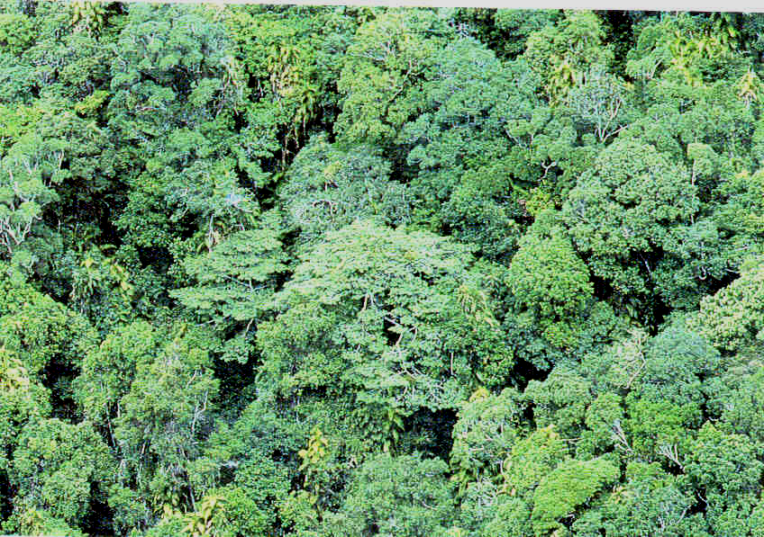
Plus de la moitié des forêts tropicales
ont été détruites….

Slide 12
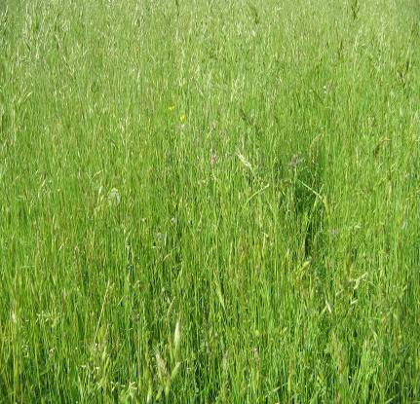
Les prairies tempérées
Température : été : 30°C,
hiver : -40°C, 20°C en Moy.
Pluies : 250 (steppe, pampa, …),
à 900 mm/an (prairies,…)
Sol : riche et profond
Végétation: trèfle, sauge, blé,
avoine, orge, herbes rases,
quelques arbres rares.
Faune : mammifères, insectes.
Situation : Grandes Plaines d’Amérique Centrale et du Nord, Steppes du Centre de l’Eurasie, Veldts d'Afrique du Sud, Puszta de Hongrie, Pampas d'Argentine et de l'Urugay, Plaines d’Australie
Utilisation agricole de nombreuses
prairies
Saison de croissance : 120-200 j
Notes:
Grasslands are generally open and continuous, fairly flat areas of grass. They are often located between temperate forests at high latitudes and deserts at subtropical latitudes. Grasses vary in size from 2.1 m (7 ft) tall with roots extending down into the soil 1.8 m (6 ft), to the short grasses growing to a height of only 20 to 25 cm (8 to 10 in) tall. These short grasses can have roots that extend 1 m (about 3 ft) deep.
The height of grass correlates with the amount of rainfall it receives. Grasslands receive about 500 to 900 mm of rain per year compared to deserts, which receive less than 300 mm and tropical forests, which receive more than 2,000 mm. While temperatures are often extreme in some grasslands, the average temperatures are about -20°C to 30°C. Tropical grasslands have dry and wet seasons that remain warm all the time. Temperate grasslands have cold winters and warm summers with some rain.
The grasses die back to their roots annually and the soil and the sod protect the roots and the new buds from the cold of winter or dry conditions. A few trees may be found in this biome along the streams, but not many due to the lack of rainfall.

Slide 13
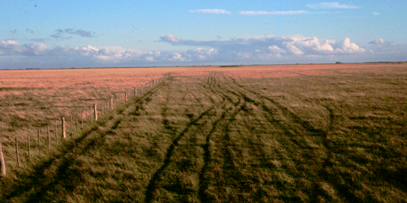
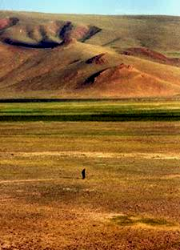
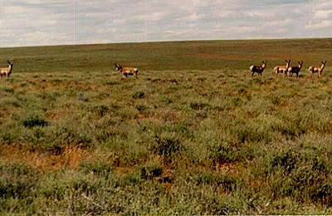
Autres grandes prairies…
Pampa d'Argentine
Veldt d'Afrique du Sud
Steppe de Mongolie

Slide 14
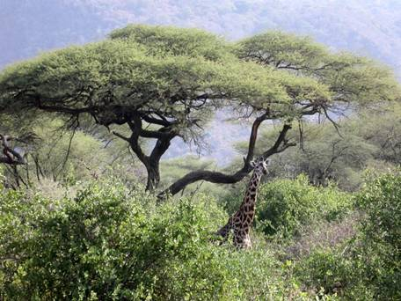
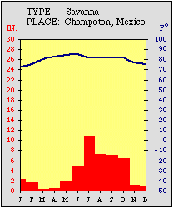
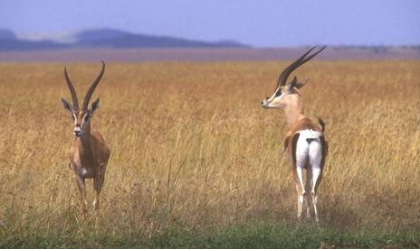
La savane
Température :
moy. > 26°C
Pluies :
500 à 1300 mm/an
sur 6 à 8 mois
(saison sèche
et feux)
Sol : poreux, très faible couche
d'humus
Végétation : Acacia, Baobab,
Eucalyptus, Cactées
Faune : girafe,zèbre, buffle, lions,
hyènes, serpents, insectes, …
Situation : Afrique, Australie, Amérique du Sud, Inde.
Tanzanie - Juillet 2003 - Jacques Janin
Kenya - - Frédéric Labaune
Notes:
Shrublands include regions such as chaparral, woodland and savanna. Shrublands are the areas that are located in west coastal regions between 30° and 40° North and South latitude. Some of the places would include southern California, Chile, Mexico, areas surrounding the Mediterranean Sea, and southwest parts of Africa and Australia. These regions are usually found surrounding deserts and grasslands.
Shrublands usually get more rain than deserts and grasslands but less than forested areas. Shrublands typically receive between 200 to 1,000 millimeters of rain a year. This rain is unpredictable, varying from month to month. There is a noticeable dry season and wet season.
The shrublands are made up of shrubs or short trees. Many shrubs thrive on steep, rocky slopes. There is usually not enough rain to support tall trees. Shrublands are usually fairly open so grasses and other short plants grow between the shrubs.
In the areas with little rainfall, plants have adapted to drought-like conditions. Many plants have small, needle-like leaves that help to conserve water. Some have leaves with waxy coatings and leaves that reflect the sunlight. Several plants have developed fire-resistant adaptations to survive the frequent fires that occur during the dry season.

Slide 15
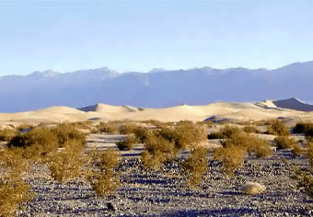
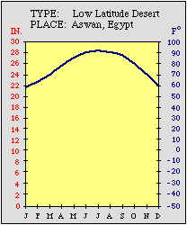
Les déserts chauds et secs
Température: -4°C (nuit)
à +38° (jour)
évaporation>pluies
Pluies : < 200 mm/an
Déserts d'Atacama (Chili),
du Sahara pluies<1.5 cm/an
Sol : mince très drainé, pas d'eau
souterraine.
Végétation: broussailles, cactées et
succulentes, herbes rases
Animaux : quelques carnivores, reptiles,
arachnides, insectes, oiseaux.
Situation: Amérique du Nord et Centrale (Chihuahuan, Sonoran, Mojave), Amérique duSud (Atacama), Asie du Sud, Afrique (Sahara, Ethiopie), Australie.
©Ph. F. Ramade
Sud marocain - janvier 1987 - André Lardon
Faune et flore adaptées aux conditions particulières en eau (feuilles, activité nocturne, …).
Écosystèmes fragiles
Notes:
Desert biomes are the driest of all the biomes. In fact, the most important characteristic of a desert is that it receives very little rainfall. Most deserts receive less than 300 mm a year compared to rainforests, which receive over 2,000 mm. That means that the desert only gets 10 percent of the rain that a rainforest gets! The temperature in the desert can change drastically from day to night because the air is so dry that heat escapes rapidly at night. The daytime temperature averages 38°C while in some deserts it can get down to -4°C at night. The temperature also varies greatly depending on the location of the desert.
Since desert conditions are so severe, the plants that live there need to have adaptations to compensate for the lack of water. Some plants, such as cacti, store water in their stems and use it very slowly, while others like bushes conserve water by growing few leaves or by having large root systems to gather water or few leaves. Some desert plant species have a short life cycle of a few weeks that lasts only during periods of rain.

Slide 16
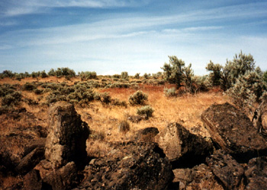
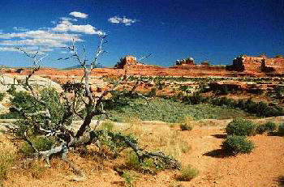
Les déserts semi-arides
Température : 21-27° C (10°C nuit,
38°C jour)
Pluies : 200 à 400 mm/an
Sol : sable et graviers, pas d'eau
souterraine.
Végétation : plantes épineuses, à
feuilles argentées ou vernissées,
arbustes, …
Animaux : lapins, quelques
carnivores, reptiles, arachnides,
insectes, oiseaux.
Situation: Amérique du Nord (Montana, Utah, zones subarctiques ), Russie, Europe et Asie du Nord.
www.worldbiomes.com
Notes:
Desert biomes are the driest of all the biomes. In fact, the most important characteristic of a desert is that it receives very little rainfall. Most deserts receive less than 300 mm a year compared to rainforests, which receive over 2,000 mm. That means that the desert only gets 10 percent of the rain that a rainforest gets! The temperature in the desert can change drastically from day to night because the air is so dry that heat escapes rapidly at night. The daytime temperature averages 38°C while in some deserts it can get down to -4°C at night. The temperature also varies greatly depending on the location of the desert.
Since desert conditions are so severe, the plants that live there need to have adaptations to compensate for the lack of water. Some plants, such as cacti, store water in their stems and use it very slowly, while others like bushes conserve water by growing few leaves or by having large root systems to gather water or few leaves. Some desert plant species have a short life cycle of a few weeks that lasts only during periods of rain.

Slide 17
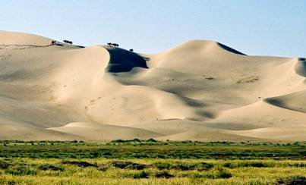
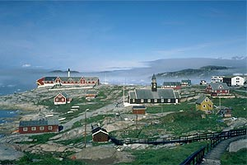
Les déserts froids
Température et précipitations :
grande diversité des situations :
hiver long et froid, vents forts /
été court modérément chaud,
pluies/neige très faibles.
Sols : lourds, argileux et salés
Végétation : aucune à très maigre,
lichens, arbustes…
Animaux : terrestres rares
(rongeurs, insectes, …), / zones
marines plus riches
⇨adaptations des EV
Situation : Antarctique, Groenland,
= Turkestan, déserts de Gobi, de
Namibie, glaciers, …
Crédits Photos : Raid ISC Groenland 2003
Désert de Gobi
Groenland
Notes:
Desert biomes are the driest of all the biomes. In fact, the most important characteristic of a desert is that it receives very little rainfall. Most deserts receive less than 300 mm a year compared to rainforests, which receive over 2,000 mm. That means that the desert only gets 10 percent of the rain that a rainforest gets! The temperature in the desert can change drastically from day to night because the air is so dry that heat escapes rapidly at night. The daytime temperature averages 38°C while in some deserts it can get down to -4°C at night. The temperature also varies greatly depending on the location of the desert.
Since desert conditions are so severe, the plants that live there need to have adaptations to compensate for the lack of water. Some plants, such as cacti, store water in their stems and use it very slowly, while others like bushes conserve water by growing few leaves or by having large root systems to gather water or few leaves. Some desert plant species have a short life cycle of a few weeks that lasts only during periods of rain.

Slide 18
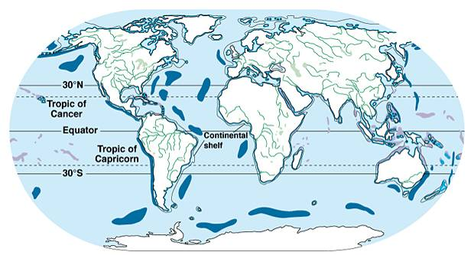
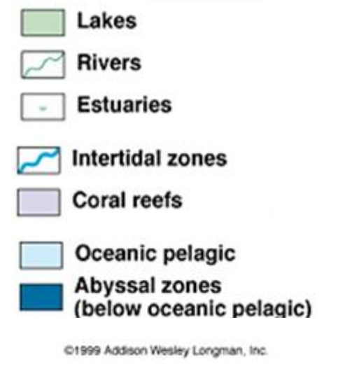
Les biomes aquatiques
La terre = 71 % d'eau
97,2% d’eau salée : Biomes marins
2,8% d’eau douce : Biomes dulcicoles
http://www.biol.andrews.edu/fb/spring/ch50/lect50.html

Slide 19
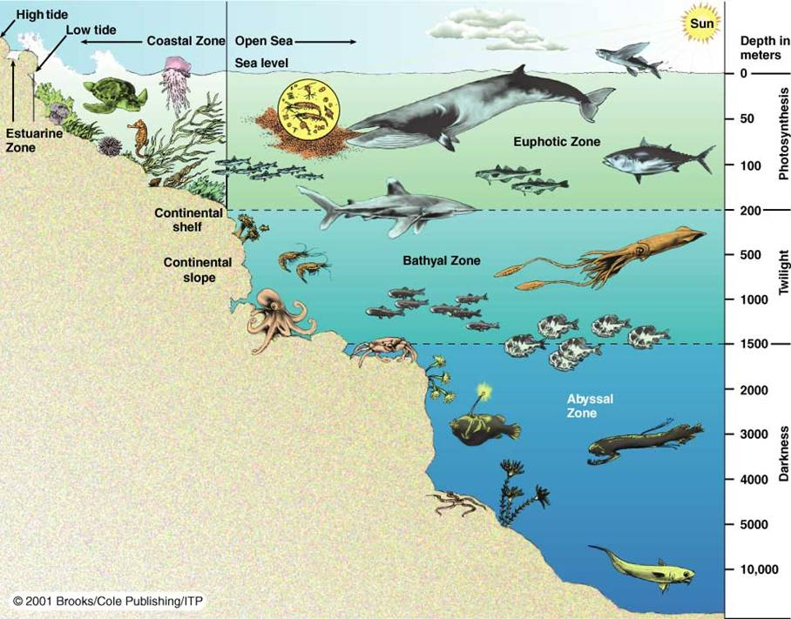
Les biomes marins
- Zones côtières
- Zones de Pleine mer

Slide 20
Biomes marins de la zone côtière
Eaux côtières, estuaires, lagons
  interface entre milieux marins et d’eau douce, et entre
  continents et océans.
  rôle essentiel pour la reproduction de nombreuses
  espèces
Récifs coralliens
  écosystème dominant des régions tropicales
  riches en biodiversité mais fragiles
Plateaux continentaux
  productivité élevée
  forte variabilité inter-annuelle (El Niño et La Niña)
Notes:
Desert biomes are the driest of all the biomes. In fact, the most important characteristic of a desert is that it receives very little rainfall. Most deserts receive less than 300 mm a year compared to rainforests, which receive over 2,000 mm. That means that the desert only gets 10 percent of the rain that a rainforest gets! The temperature in the desert can change drastically from day to night because the air is so dry that heat escapes rapidly at night. The daytime temperature averages 38°C while in some deserts it can get down to -4°C at night. The temperature also varies greatly depending on the location of the desert.
Since desert conditions are so severe, the plants that live there need to have adaptations to compensate for the lack of water. Some plants, such as cacti, store water in their stems and use it very slowly, while others like bushes conserve water by growing few leaves or by having large root systems to gather water or few leaves. Some desert plant species have a short life cycle of a few weeks that lasts only during periods of rain.

Slide 21
Biomes marins de pleine mer
Mers ouvertes
  aire et volume le plus important des écosystèmes
  marins
  production biologique faible
Océans polaires
  écosystèmes très productifs
  grande variabilité saisonnière (poissons, krill, baleines, petits cétacés).

Slide 22
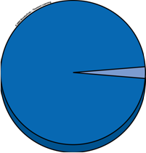
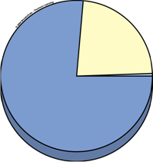
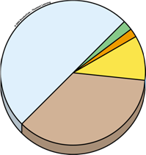
Les biomes dulçaquicoles
Salinité < 1%
All water
Fresh water
Readily accessible fresh water
Superficial freshwaters
Groundwater
0.592%
Biota
0.0001%
Oceans and
saline lakes
97.4%
Lakes 0.007%
Rivers
0.0001%
Fresh water
2.6%
0.014%
Oceans 97.41 %
Ice caps
and glaciers
1.984%
Soil
Moisture
0.005%
Atmospheric
water vapor
0.001%
From : "Living in the Environment, G.T. MILLER, 2003, Brooks & Cole ed.

Slide 23
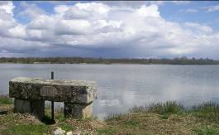
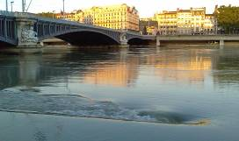
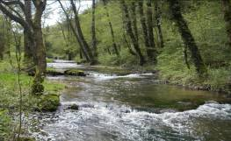
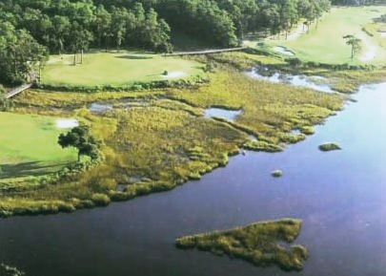
Les biomes dulçaquicoles
Écosystèmes d'eau stagnante :
lacs, étangs,
mares, marais,
gravières, …
Écosystèmes d'eau courante :
fleuves, rivières, …
Les zones humides

Slide 24
Richesse spécifique par type de biome
Biomes | % du total de la biosphère | % des espèces connues * | Richesse spécifique relative **
Dulcicoles | 0,008 | 0,024 | 3,0
Terrestres | 0,284 | 0,775 | 2,7
Marins | 0,708 | 0,147 | 0,2
Source : Vitousek & al., 1997 : Science 277:494-509.
5,3% d'espèces symbiotiques à rajouter
** % d'espèces connues / % de surface occupée par l'écosystème

Slide 25
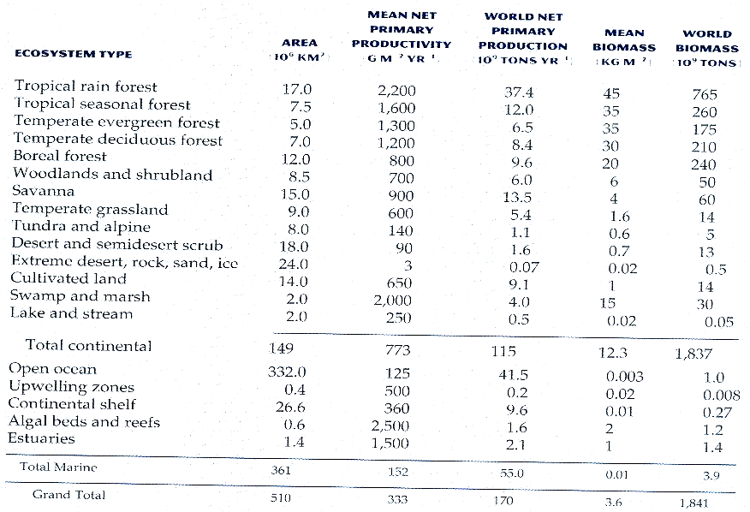
Productivité des grands biomes
In « Ecology » par P. Stiling, 1999, Prentice hall ed.

